Slide 1
Batteries
Batteries and battery packs are made up from groups of cells
These cells can be wired together in series, in parallel, or in some combination of both
Sometimes they are packaged in a single physical unit,
e.g., 12V lead-acid battery (6x2V Cells in Series)
Other times, the connections are external to the cells

Slide 2
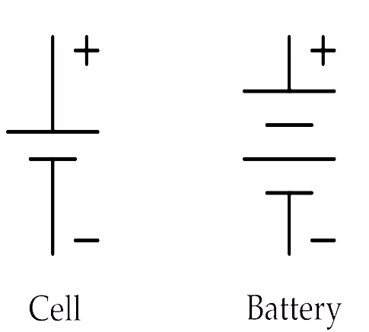
Cell VS Battery

Slide 3
Nominal Voltage
• Cell (nominal) voltage depends on the combination of active chemicals used in the cell.
• For many lithium-based cells, this is over 3V
• Nominal voltage is often printed on the cell package
• Nominal voltage is different from cell voltage under load—it is more of an average or typical voltage.

Slide 4
Nominal Capacity
Cell (nominal) capacity specifies the quantity of charge.
It is in ampere hours (Ah) or milliampere hours (mAh), that the cell is rated to hold.
Nominal capacity is also often printed on the cell package.

